Slide 1

Email Spam Classification
2
+
2
+
Project Presentation

Slide 2


Presented by
2
+
2
+
2
+
Atia Bibi
Ayesha Khalid
Maryam Yasmeen
Irum Rahat
Mubashra Tanveer

Slide 3

INTRODUCTION
2
+
Spam emails are emails sent to a large group of recipients without their prior consent, typically advertising for goods and services or business opportunities.
A spam email classification is a step towards building a tool for scam message identification and early scam detection.

Slide 4

OBJECTIVE
In the recent period, the percentage of scam messages amongst spam have increased sharply. Scam messages typically trick people into giving away money or personal details by offering an attractive or false deal.
So email spam classification will solve this problem by detecting spam emails.

Slide 5
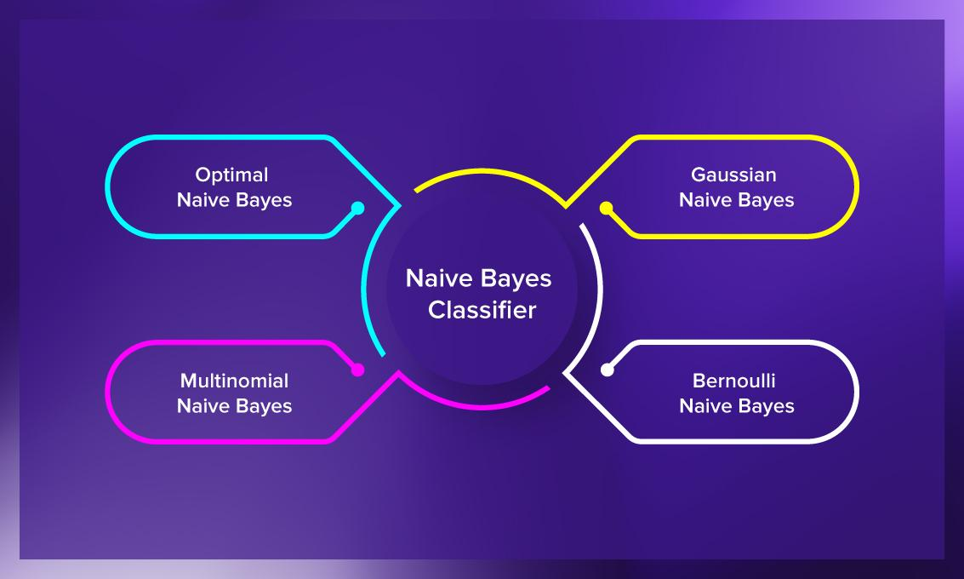
Algorithm
Naïve Bayes Classifier
The Naive Bayes classification algorithm is a probabilistic classifier. It is based on probability models that incorporate strong independence assumptions.
We select Multinomial Naïve Bayes algorithm because it gives high accuracy score as compare to others.

Slide 6
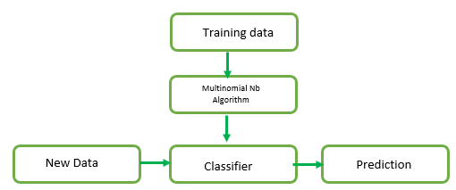
Dry run of Algorithm
2
+

Slide 7
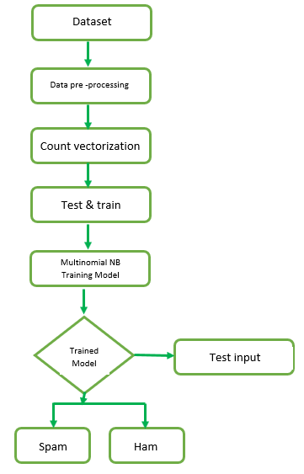
Flow chart diagram

Slide 8
Tools & Technologies used
1
Anaconda (Jupyter)
2
Visual Studio code
3
Notepad

Slide 9
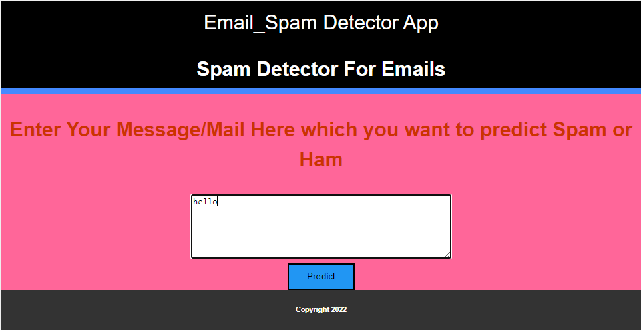
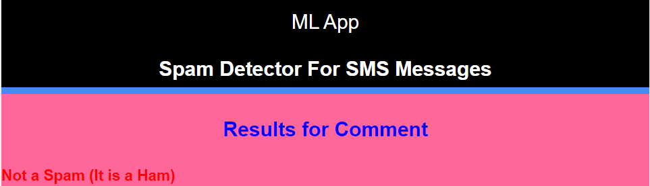
Output
2
+

Slide 10
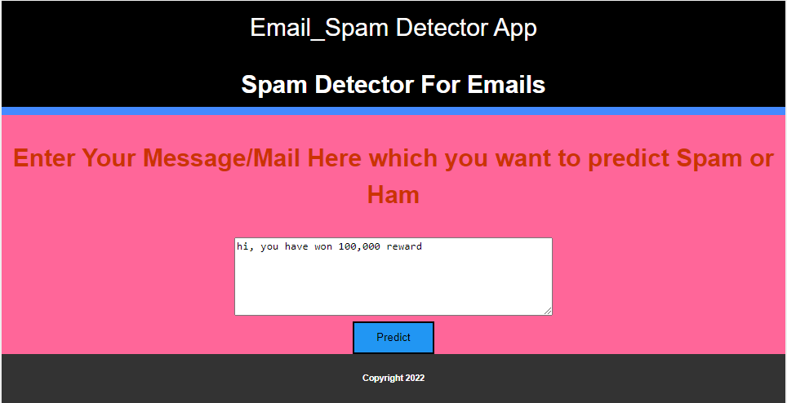
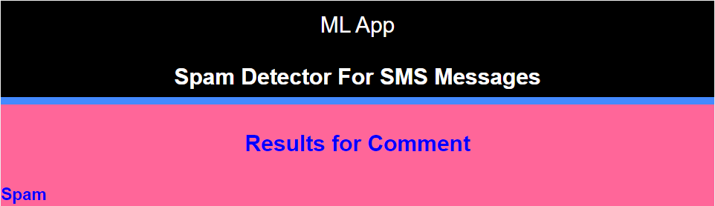
Output
2
+

Slide 11

YouTube link
2
+
https://youtu.be/sOje7qd2srQ

Slide 12
THANK YOU
2
+
2
+

